Slide 1
Lecture 5 Sept. 9th ,2019
Lab report 1 due Thursday, Sept 12th at the beginning of your lab.
Questions?-

Slide 2
Where were we?
Cell cycle---Sketch it. Think about the details of Interphase, and Mitosis
Cells will be 2N in mitosis, but each chromosome will duplicate in S-phase
How did your practice with a mosquito somatic cell go?
How many chromosomes after S-phase?
How many chromatids after S-phase?

Slide 3
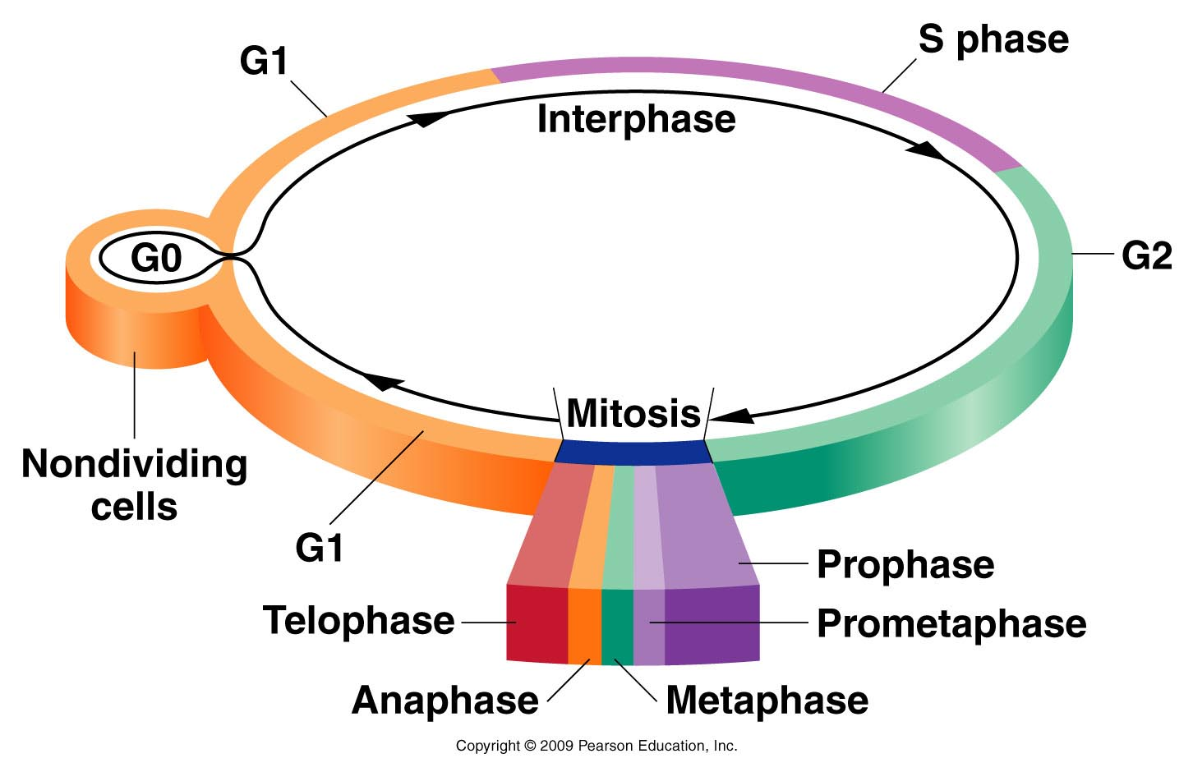
Figure 2.5
Notes:
Figure 2-5 The intervals comprising an arbitrary cell cycle. Following mitosis, cells enter the G1 stage of interphase, initiating a new cycle. Cells may become nondividing (G0) or continue through G1, where they become committed to begin DNA synthesis (S) and complete the cycle (G2 and mitosis). Following mitosis, two daughter cells are produced and the cycle begins anew for both cells.

Slide 4
Cell cycle must be carefully regulated
In multicellular organisms, cells divide at different rates depending on their lifespan and purpose. (Cell division is most rapid during embryonic development. After that, cells of different tissues divide at different rates)
Cancer is the result of dis-regulated cell division. (Chapter 19*—Please read and study Sections 19.3 through 19.6)

Slide 5
The cell cycle can pause if necessary at specific points if the cell is not ready to advance to produce two perfect daughter cells
Cell cycle checkpoints
G1/S border—cell monitors its size and DNA quality
G2/M border---cell monitors completeness of DNA synthesis and checks for DNA damage
Within mitosis—Cell monitors spindle formation proper attachment of spindle to chromosomes

Slide 6
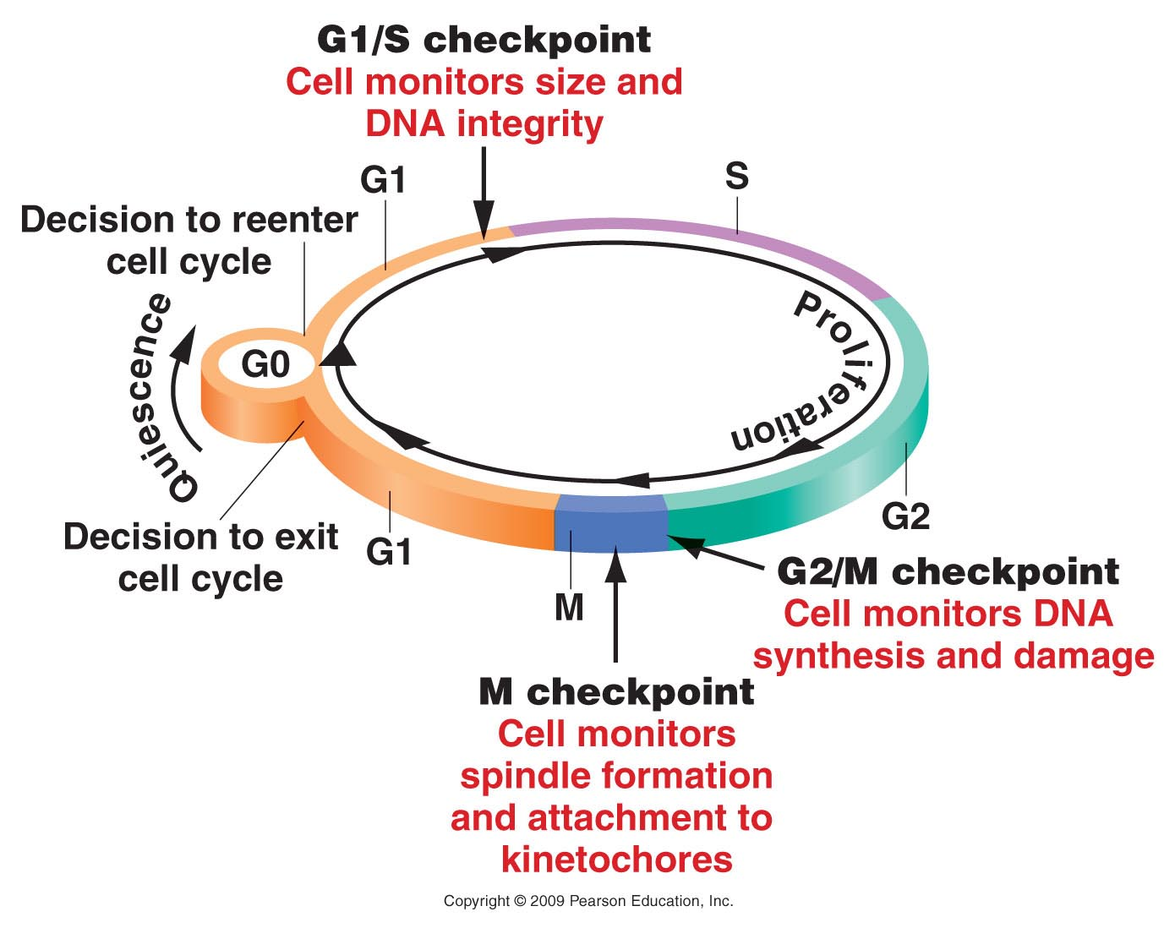
Figure 20.5
Notes:
Figure 20-5 Checkpoints and proliferation decision points monitor the progress of the cell through the cell cycle.

Slide 7
Normally a cell will pause (at one of the checkpoints) if it has incurred DNA damage or lacks the resources it needs to carry out perfect cell division.

Slide 8
If these checkpoints fail, a cell will start to accumulate DNA damage(mutations in genes), which in turn may lead to more defects in the checkpoints (which control cell division rate)….so the cell divides more…which causes it to replicate its DNA more, which leads to more mutations, some of which are in checkpoint genes....so the cell divides more....

Slide 9
Cells that have accumulated many mutations, such that regulation of cell division/mitosis is lost--- become piles of cells--tumors----CANCER.

Slide 10
Let’s clarify--
Cancer is an abnormal accumulation of cells.
Each cancer is essentially clonal---originating from one cell.
The original cell has lost some aspect of cell division control, which can lead to further loss of control— and the result is lots of cells.

Slide 11
Some of the DNA damage/mutations are easy to spot.
Extra chromosomes
Missing chromosomes
Broken or fused chromosomes
Since genes reside on/in chromosomes, extra chromosomes mean extra copies of genes, missing chromosomes mean missing genes…broken and fused chromosomes mean parts of genes may be missing or fused together.

Slide 12
Karyotype from tumor cells from brain cancer---YIKES!

Slide 13
If working normally, a cell cycle pause may allow the cell to repair DNA damage, accumulate resources, or grow so that it can divide and produce 2 healthy cells.

Slide 14
Figure 20.5
Notes:
Figure 20-5 Checkpoints and proliferation decision points monitor the progress of the cell through the cell cycle.

Slide 15
Specific proteins work together to move the cell past cell cycle checkpoints.
Cyclins (which accumulate and disappear over time—in cycles)
Cyclin-dependent kinases (proteins which bind to cyclins and are enzymes which add phosphate groups to other proteins.

Slide 16
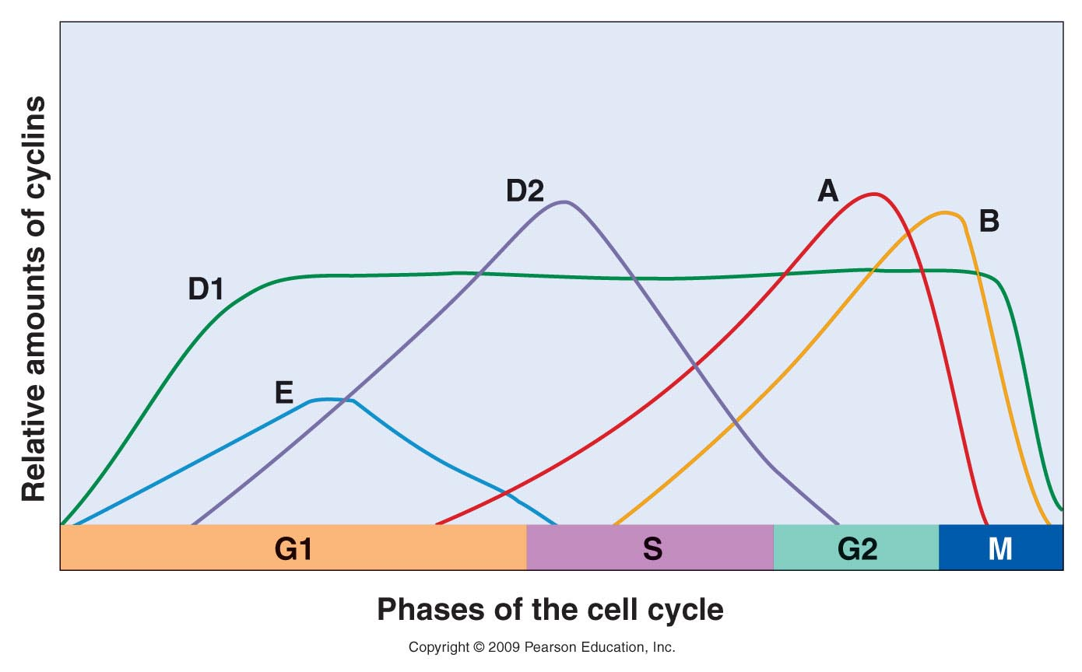
Figure 20.6
Notes:
Figure 20-6 Relative expression times and amounts of cyclins during the cell cycle. Cyclin D1 accumulates early in G1 and is expressed at a constant level through most of the cycle. Cyclin E accumulates in G1, reaches a peak, and declines by mid S phase. Cyclin D2 begins accumulating in the last half of G1, reaches a peak just after the beginning of S, and then declines by early G2. Cyclin A appears in late G1, accumulates through S phase, peaks at the G2/M transition, and is rapidly degraded. Cyclin B peaks at the G2/M transition and declines rapidly in M phase.

Slide 17
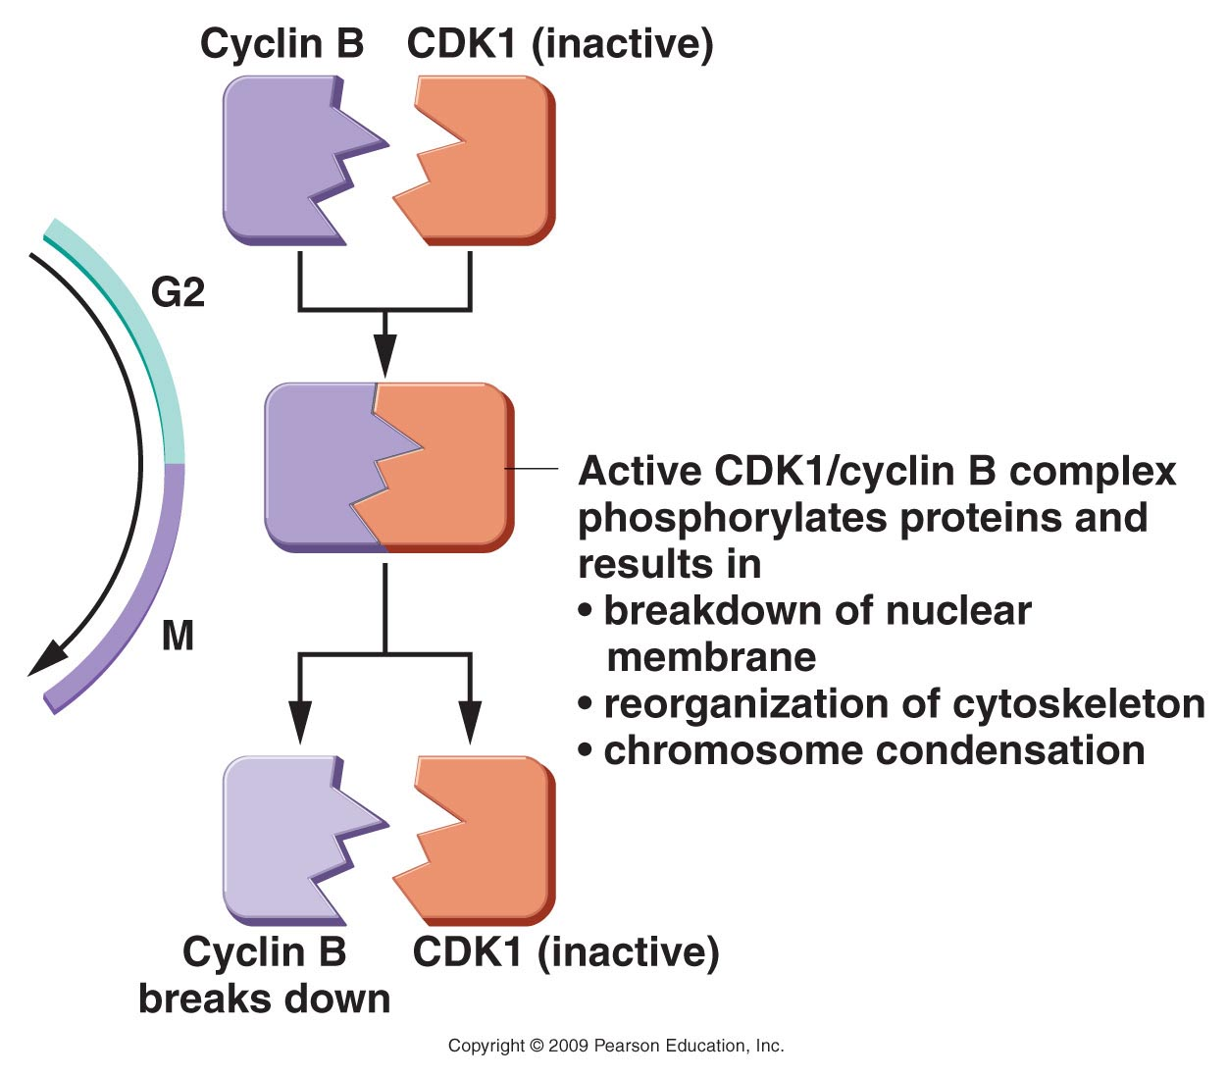
Figure 20.7
Notes:
Figure 20-7 Transition from G2 to M phase is controlled by CDK1 and cyclin B. These molecules interact to form a complex that adds phosphate groups to cellular components. These in turn bring about the structural and biochemical changes necessary for mitosis (M phase).

Slide 18
Some cells cannot safely progress to/through mitosis---then what?
Cells with incomplete DNA replication or severely damaged DNA must not divide—cannot risk passing on incomplete or damaged genome to new cells.
These cells normally undergo a controlled, programmed cell death—APOPTOSIS
Sacrificing one cell saves the organism if it prevents the development of cancer.

Slide 19
Many genes/proteins are involved in cell cycle regulation
Cyclins
CDKs
P53
RB1
BAX
Promote cell division
Inhibit cell division or promote apoptosis

Slide 20
So-called “cancer genes” are really mutant forms of genes that regulate cell division
Proto-oncogenes---genes that promote cell division (mutant forms push cells to divide too often)
Tumor-suppressor genes—genes that stop or slow cell division (mutant forms fail to stop cells from dividing when they have defects in DNA)

Slide 21
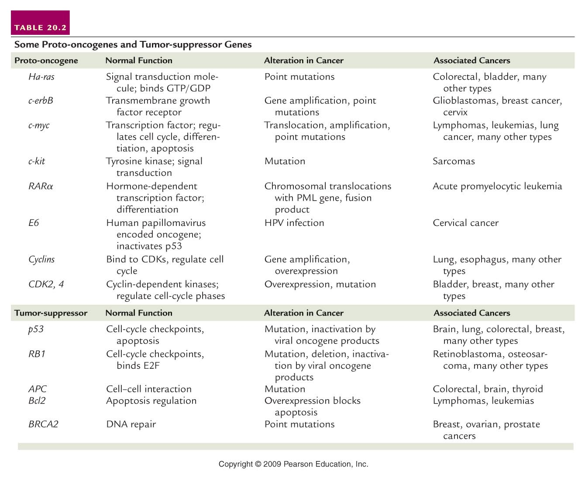
Table 20.2
Notes:
Table 20-2 Some Proto-oncogenes and Tumor Suppressor Genes

Slide 22
P53 (TP53) is the most famous/“infamous” gene associated with human cancer
Normal role is to prevent passage of cell cycle checkpoints in cells with damaged DNA
Regulates cell cycle progression by sensing multiple sources of damage
Loss of both normal copies of p53 results in cells dividing with DNA damage---accumulation of damage, ultimately leads to complete loss of cell division control---cancer.
>50% of all types of cancer show loss of normal p53 activity.

Slide 23
Let’s return to chromosomes
Structurally, what is the different about chromosomes in a cell that is in mitosis and chromosomes in a cell that is in interphase?

Slide 24
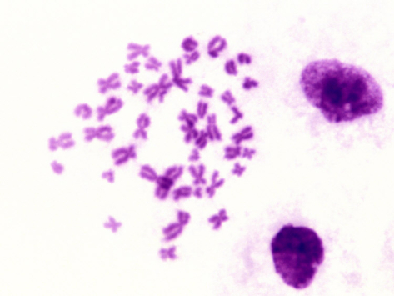
The level of condensation.

Slide 25
The level of condensation.
Decondensed, interphase chromosomes
Condensed, metaphase chromosomes

Slide 26
How does it happen?---let’s think about how chromosomes condense-shorten and thicken in preparation for distribution into 2 new daughter cells.
*The only reason the chromosomes become visible in the microscope is because they are thicker.

Slide 27
Chromosomes are DNA associated with proteins
DNA binds and wraps around complexes of histone proteins to form the basic level of DNA structure in cells---the nucleosome.
Nucleosomes associate with each other and with other proteins as the chromosome condenses.
DNA and its associated proteins is referred to chromatin (sometimes the thinnest form of chromosomes, in interphase, is called chromatin)

Slide 28
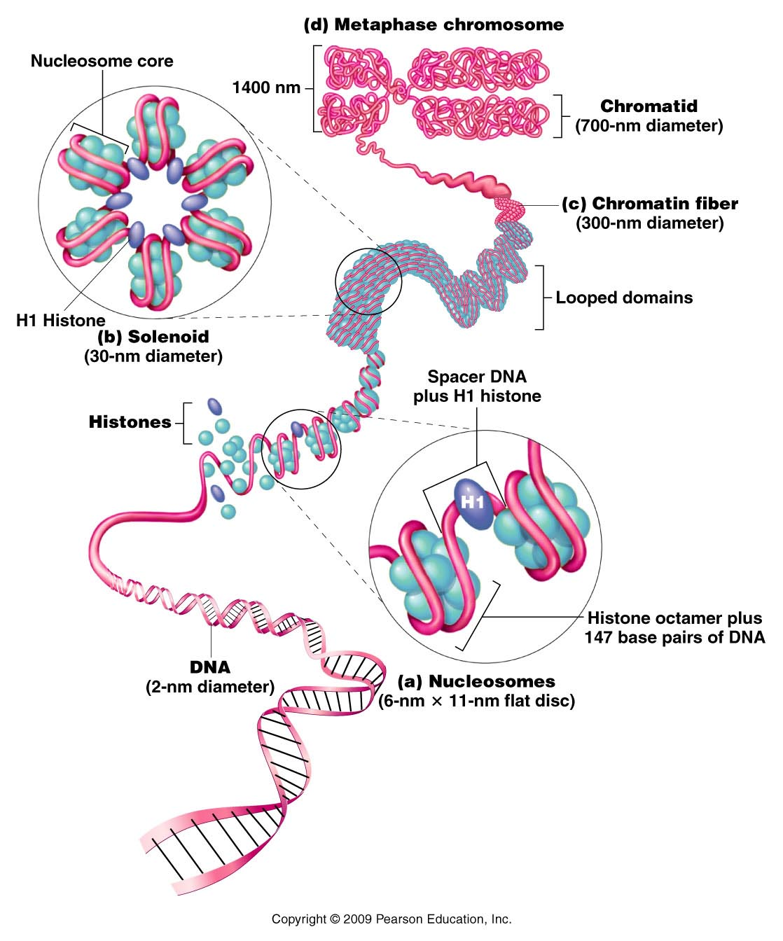
Figure 12.9
Notes:
Figure 12-9 General model of the association of histones and DNA in the nucleosome, illustrating the way in which the chromatin fiber may be coiled into a more condensed structure, ultimately producing a mitotic chromosome.

Slide 29
Variation in condensation
Even in fully condensed chromosomes, regions will be coiled more or less tightly than other regions.
DNA takes up stains differently depending on its level of condensation. This gives rise to the unique banding pattern that allows identification of individual chromosomes.

Slide 30
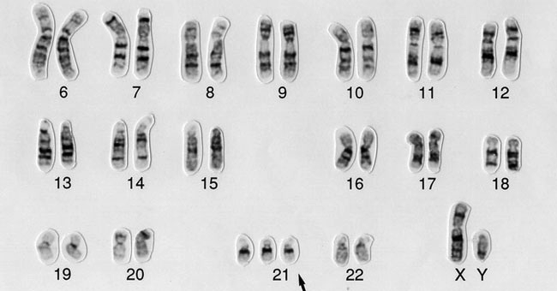

Slide 31
Likewise…in interphase chromosomes (least condensed state) the chromosome varies in level of condensation:
Generally speaking, the more tightly coiled, the less accessible the DNA is for gene expression.
Modification of DNA and of histone proteins affects how coiled/accessible the DNA is.

Slide 32
The study of the level of condensation/compaction of DNA is one aspect of a very important field of genetics called epigenetics.
Epigenetics deals with features and alterations of DNA that have nothing to do with the ATGC sequence.
We will come back to this soon.

Slide 33
*Chromosome organization/condensation
Review handout showing a cartoon of the basic levels of organization of DNA in eukaryotes.
Sections 12.4 and 12.5 are useful for more detail.

